Slide 1
Lecture-21
Mathematics 2 (15B11MA211)
CO [C106.4]
Topic:
Fourier Series
Reference for the lecture
R.K Jain and S.R.K. Iyengar, “Advanced Engineering Mathematics” Fifth edition, Narosa publishing house, 2016.

Slide 2
Fourier Series:

Slide 4
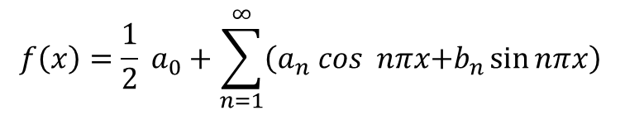
Hence,
be the required Fourier series where
$$f\left(x\right)=\frac{1}{2} a_{0}+\sum_{n=1}^{∞}{\left(a_{n} cos nπx\text{+}b_{n}\sin{nπx}\right)}$$

Slide 5
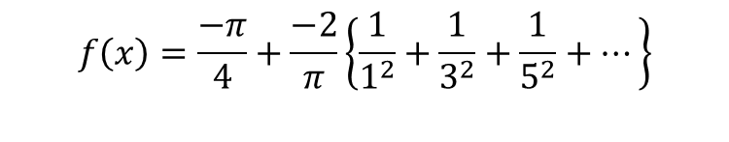
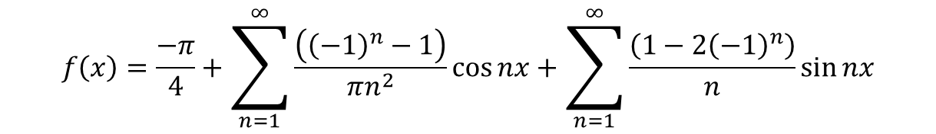
$$f\left(x\right)=\frac{−π}{4}+\sum_{n=1}^{∞}{\frac{\left({\left(−1\right)}^{n}−1\right)}{πn^{2}}\cos{nx}}+\sum_{n=1}^{∞}{\frac{\left(1−2{\left(−1\right)}^{n}\right)}{n}\sin{nx}}$$
$$f\left(x\right)=\frac{−π}{4}+\frac{−2}{π}\left\{\frac{1}{1^{2}}\cos{x}+\frac{1}{3^{2}}\cos{3x}+\frac{1}{5^{2}}\cos{5x}+⋯\right\}+\left\{\frac{3}{1}\sin{x}−\frac{1}{2}\sin{2x}+⋯\right\}$$
$$f\left(x\right)=\frac{−π}{4}+\frac{−2}{π}\left\{\frac{1}{1^{2}}+\frac{1}{3^{2}}+\frac{1}{5^{2}}+⋯\right\}$$
At x =0,
At x = 0, f(x) is discontinuous.

Slide 6
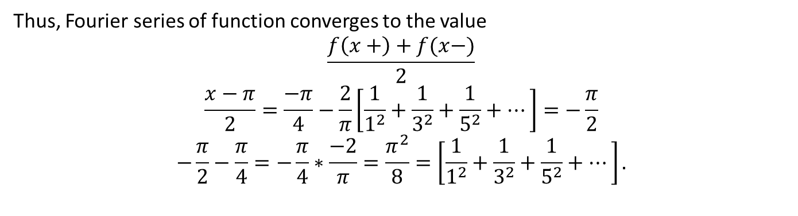
Thus, Fourier series of function converges to the value
$$\frac{f\left(x+\right)+f(x−)}{2}$$
$$\frac{x−π}{2}=\frac{−π}{4}−\frac{2}{π}\left[\frac{1}{1^{2}}+\frac{1}{3^{2}}+\frac{1}{5^{2}}+⋯\right]=−\frac{π}{2}$$
$$−\frac{π}{2}−\frac{π}{4}=−\frac{π}{4}∗\frac{−2}{π}=\frac{π^{2}}{8}=\left[\frac{1}{1^{2}}+\frac{1}{3^{2}}+\frac{1}{5^{2}}+⋯\right].$$

Slide 8

$$\frac{f\left(x+\right)+f(x−)}{2}$$

Slide 9
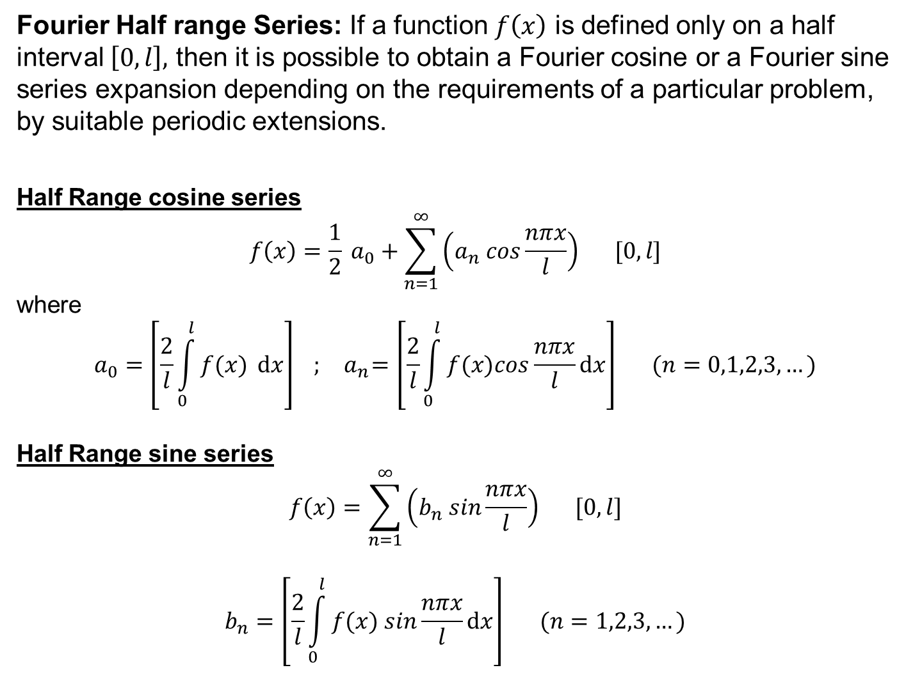
Fourier Half range Series: If a function $f\left(x\right)$ is defined only on a half interval $\left[0,l\right],$ then it is possible to obtain a Fourier cosine or a Fourier sine series expansion depending on the requirements of a particular problem, by suitable periodic extensions.
Half Range cosine series
$$f\left(x\right)=\frac{1}{2} a_{0}+\sum_{n=1}^{∞}{\left(a_{n} cos\frac{nπx}{l}\right)} [0,l]$$
where
$$a_{0}=\left[\frac{2}{l}\int_{0}^{l}{f(x) ⅆx}\right] ; { a}_{n}=\left[\frac{2}{l}\int_{0}^{l}{f(x)cos\frac{nπx}{l}ⅆx}\right] (n=0,1,2,3,…)$$
Half Range sine series
$$f\left(x\right)=\sum_{n=1}^{∞}{\left(b_{n} sin\frac{nπx}{l}\right)} [0,l]$$
$$b_{n}=\left[\frac{2}{l}\int_{0}^{l}{f(x) sin\frac{nπx}{l}ⅆx}\right] (n=1,2,3,…)$$

Slide 10
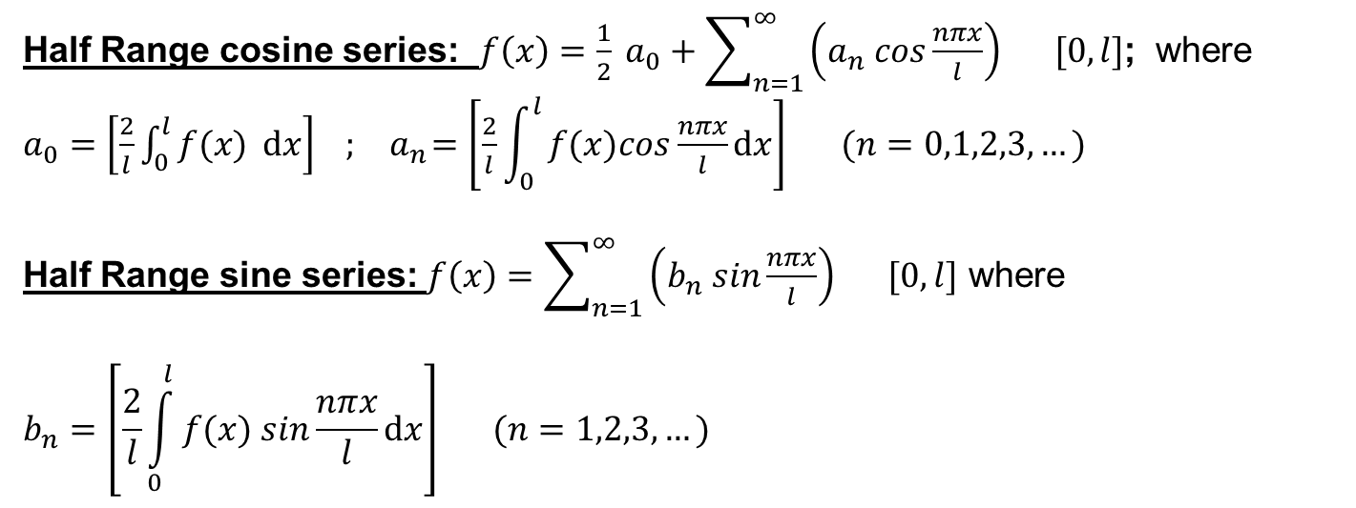
Half Range cosine series: $f\left(x\right)=\frac{1}{2} a_{0}+\sum_{n=1}^{∞}{\left(a_{n} cos\frac{nπx}{l}\right)} [0,l]$; where $a_{0}=\left[\frac{2}{l}\int_{0}^{l}{f(x) ⅆx}\right] ; { a}_{n}=\left[\frac{2}{l}\int_{0}^{l}{f(x)cos\frac{nπx}{l}ⅆx}\right] (n=0,1,2,3,…)$
Half Range sine series: $f\left(x\right)=\sum_{n=1}^{∞}{\left(b_{n} sin\frac{nπx}{l}\right)} [0,l]$ where
$$b_{n}=\left[\frac{2}{l}\int_{0}^{l}{f(x) sin\frac{nπx}{l}ⅆx}\right] (n=1,2,3,…)$$

Slide 12
Thank You

